Slide 1

Analytics and AI: Introduction

Slide 2

Agenda
What is AI?
From Ad-hoc Data Analysis to Data Driven Decisions
Options for ML models on GCP

Slide 3
Machine Learning is a type of AI, and deep learning is a type of machine learning
Class of problems we can solve when computers think/act like humans
Artificial Intelligence
Machine Learning
Deep Learning

Slide 4




ML is a way to use standard algorithms to derive predictive insights from data and make repeated decisions
1
2
3
4
Algorithm
Data
Predictive insight
Decision

Slide 5
Why are Machine Learning and Deep Learning so exciting?
Artificial Intelligence
Class of problems we can solve when computers think/act like humans
Machine Learning
Scalably solve those problems using data examples (not custom code)
Deep Learning
Even when that data consists of unstructured data like images, speech, video, natural language text, etc.

Slide 6


Keller Williams uses AutoML Vision to automatically recognize
common elements of house furnishings and architecture
Cloud AutoML Vision
“Modern” style
Granite countertops
Notes:
Keller Williams, a U.S. real estate company, uses AutoML Vision to automatically recognize specific features of houses like built-in bookcases.
This helps agents get houses listed faster and buyers find houses that meet their needs.
Neil Dholakia, Chief Product Officer says “By training a custom model to recognize common elements of furnishings and architecture, customers can automatically search home listing photos for specific features like granite countertops like ‘modern.’”
This application of machine learning quickly allows Keller Williams realtors to record a video walkthrough of a new home and use the object detection capabilities of AutoML Vision to find and tag key aspects of the home that customers would want to search on.
A big benefit for their organization is that they already had many existing images and videos of home walkthroughs already. They simply fed them into the pre-built AutoML Vision model and customized it. All without writing a line of code. You’ll learn more about AutoML Vision and practice creating models with it later in this course. [pause]
[SPEAKER] https://cloud.google.com/blog/products/gcp/empowering-businesses-and-developers-do-more-ai
[SPEAKER] https://unsplash.com/photos/G7sE2S4Lab4

Slide 7
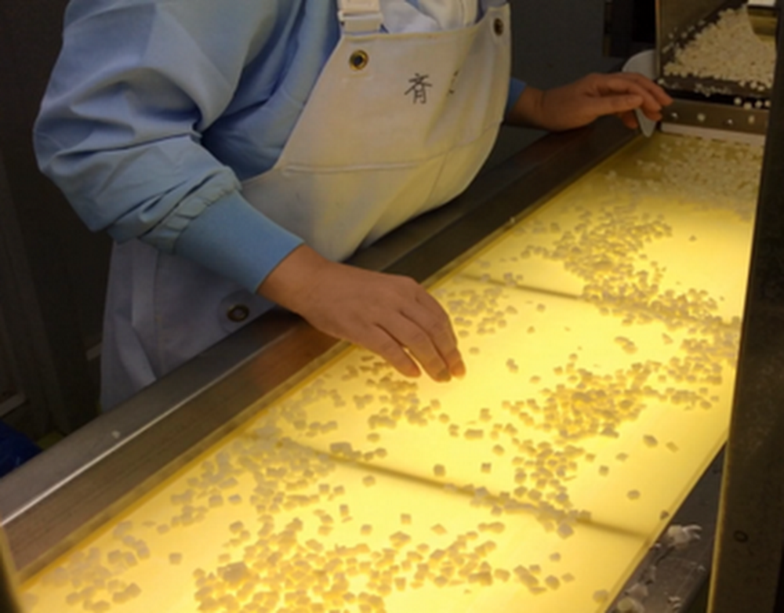

Kewpie uses ML to sort out the bad potatoes in baby food
Original process required humans to identify low-quality ingredients, which was expensive and stressful.
Machine learning was used to replicate the quality control process.
Notes:
Kewpie manufactures baby food. In this case, quality is not necessarily a matter of safety—because the food itself is safe—but discoloration can concern parents. So Kewpie turned to Google and our partner Brainpad to build a solution that leverages image recognition to detect low-quality potato cubes. The ML algorithm enabled them to free people from the tiring work of inspection and focus on other important work.
https://www.blog.google/products/google-cloud/how-ai-can-help-make-safer-baby-food-and-other-products/

Slide 8
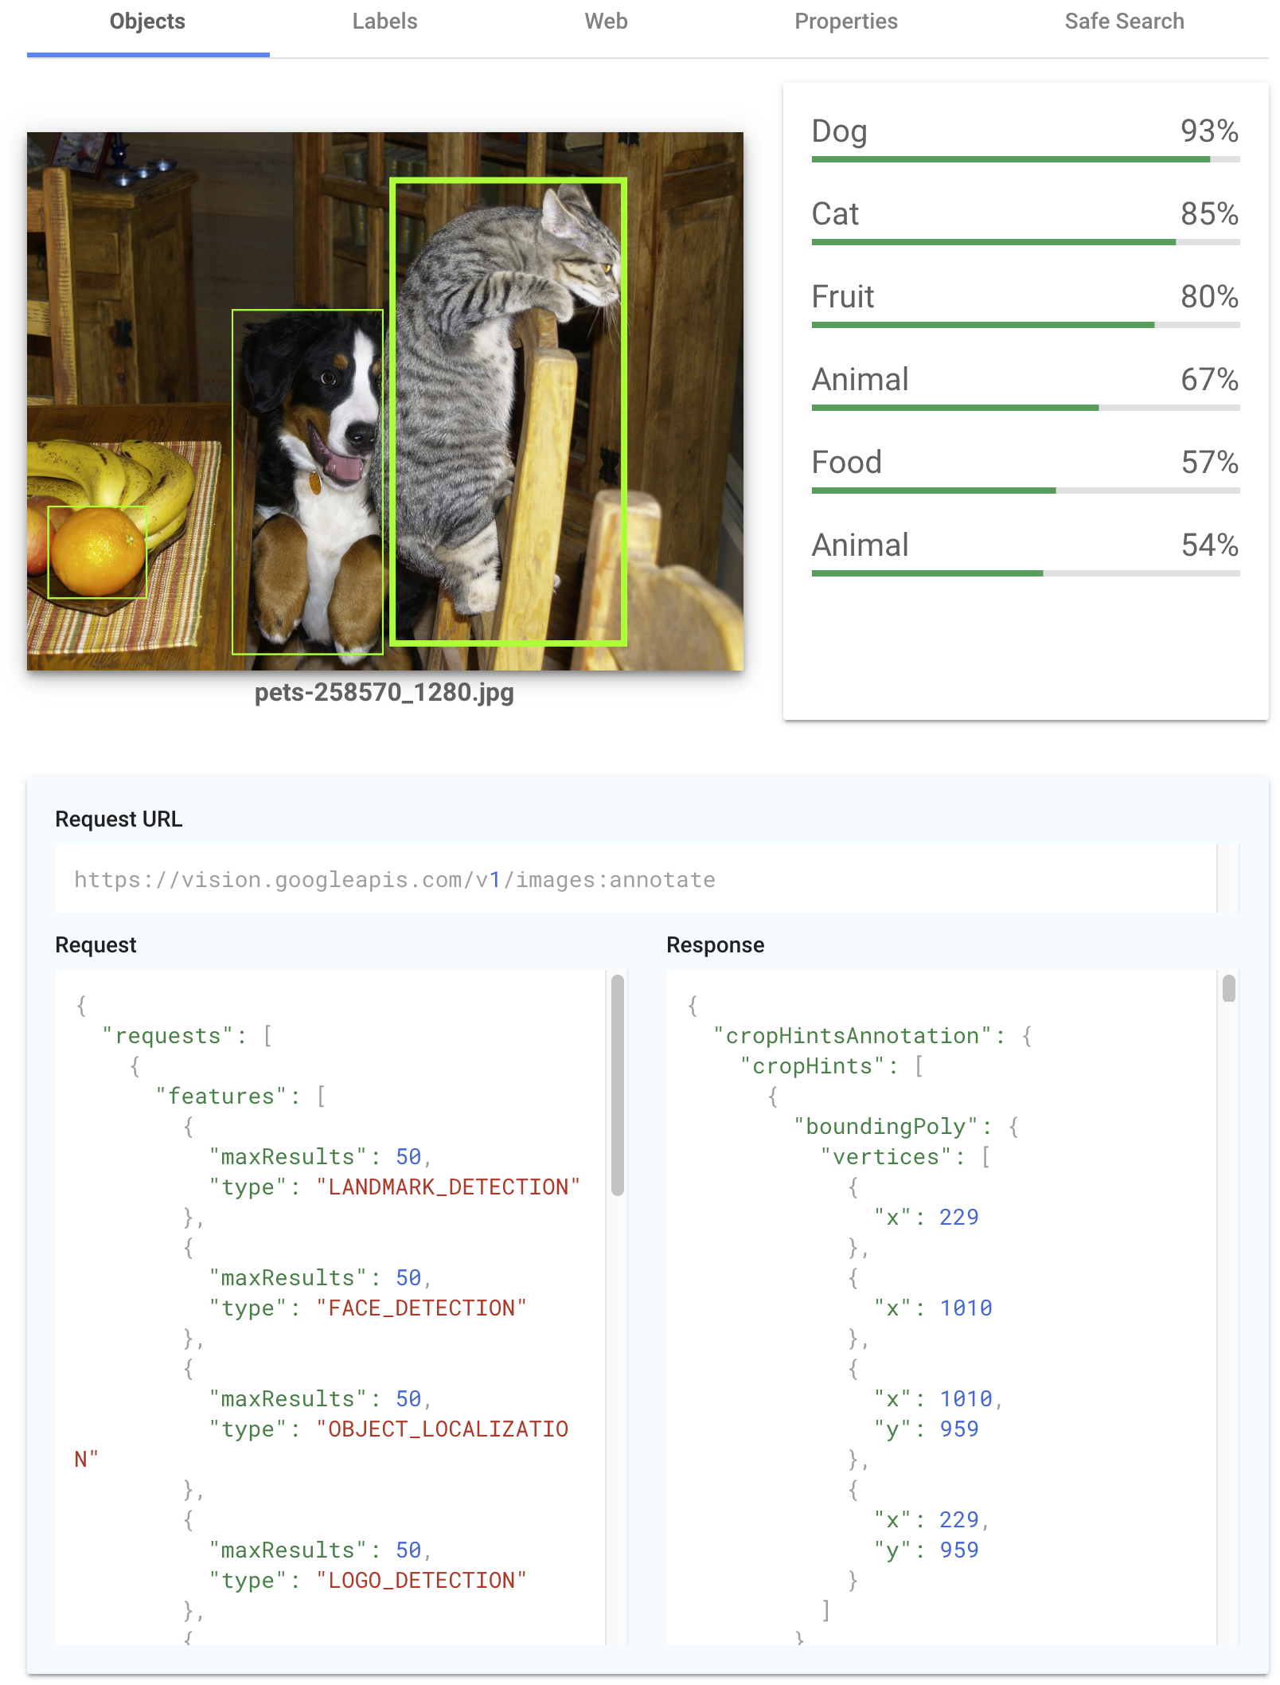
Play around with the power of AI yourself...
cloud.google.com/vision/
Object detection
Labeling and confidence
Web lookup
Pre-trained (call the API)
Notes:
https://pixabay.com/photos/pets-playful-playing-young-dog-258570/

Slide 9
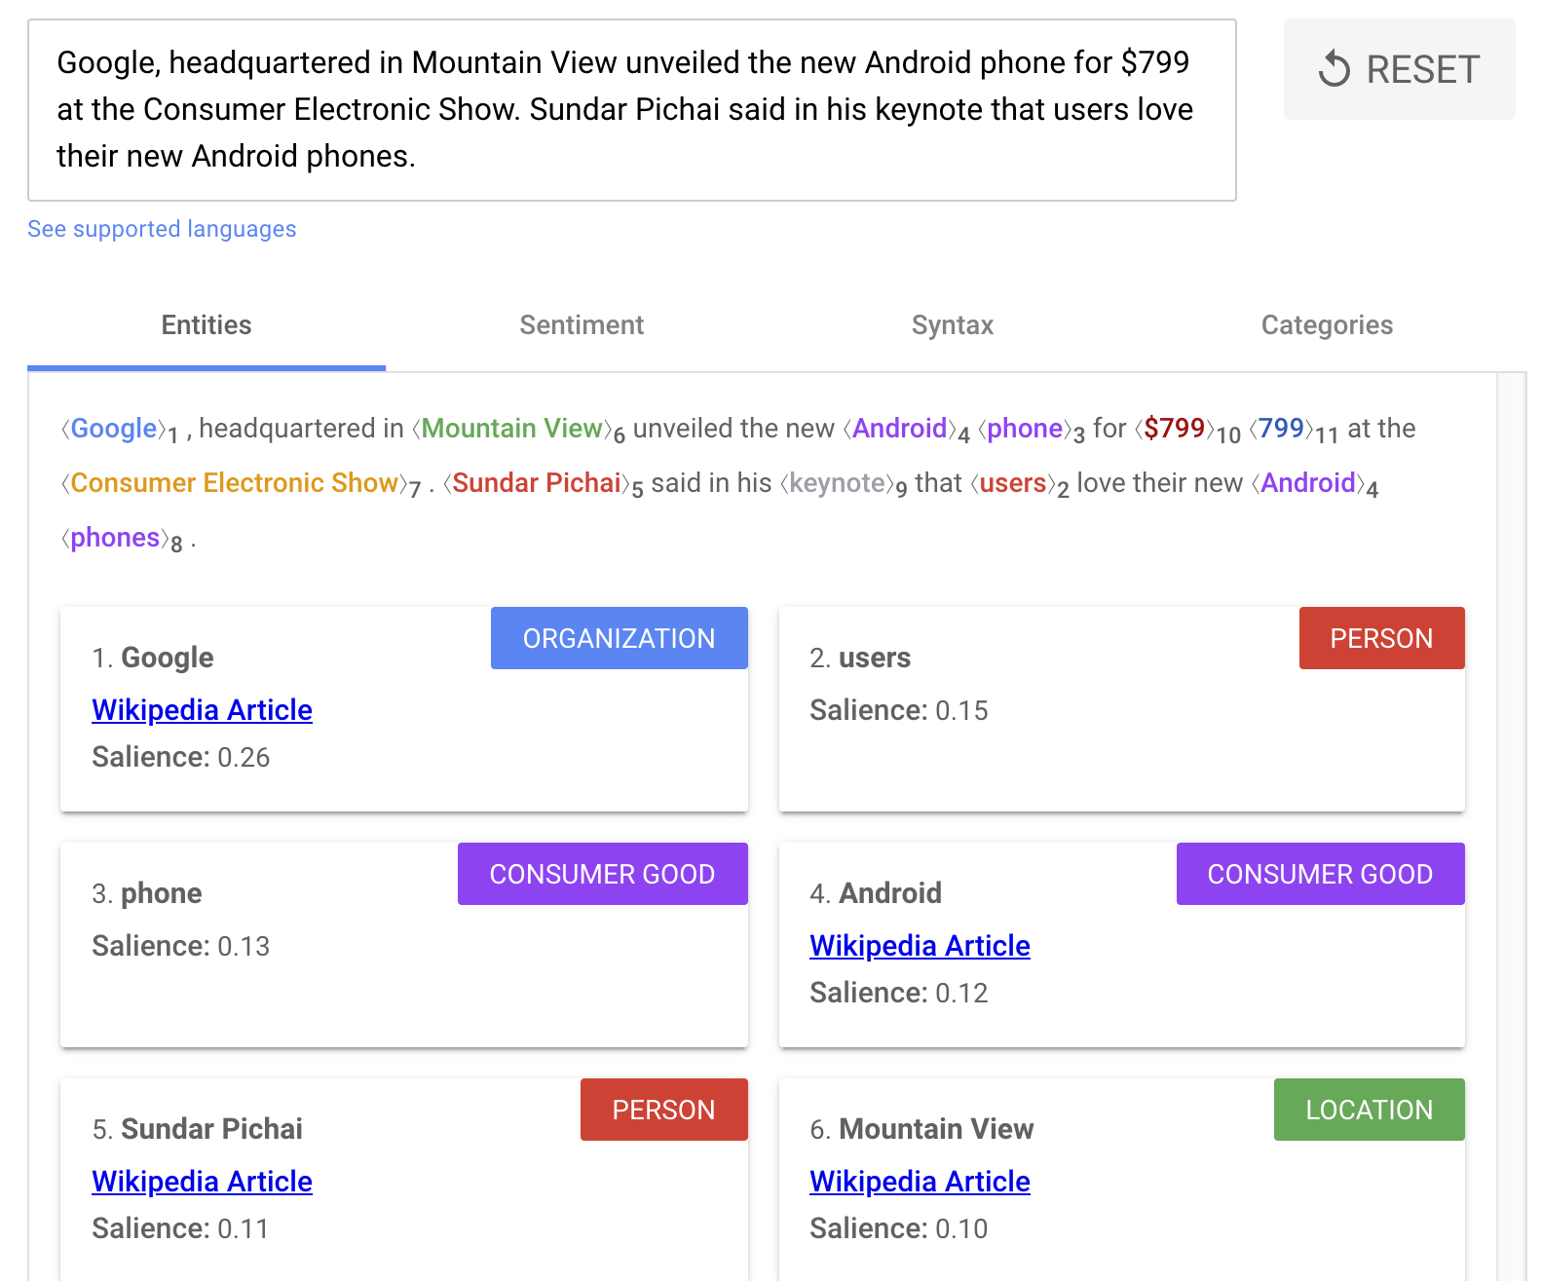
Try Google’s natural language API
cloud.google.com/natural-language/
Entity extraction
Sentiment analysis
Sentence structure
Pre-trained (call the API)

Slide 10
Agenda
AI
From Ad-hoc Data Analysis to Data Driven Decisions
Options for ML models on GCP

Slide 11

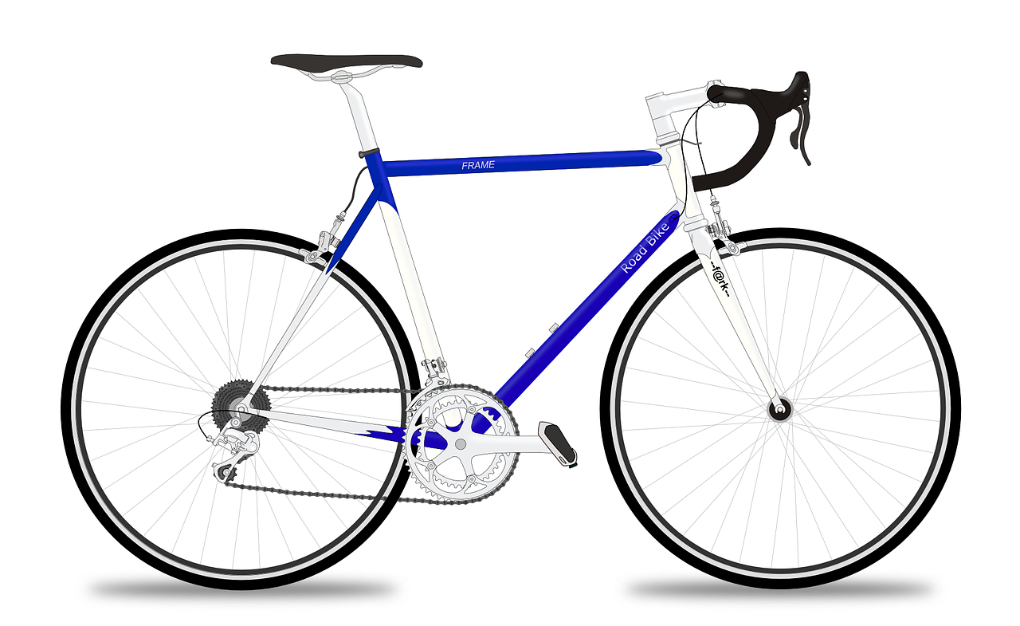
Imagine you’re the owner of a bicycle rental business (in London). How do you stock enough bicycles?
Commuter Bikes
If rental is likely to be for a short duration, we need to have commuter bikes in stock
Road Bikes
If rental is likely to be for a long duration, we need to have road bikes in stock
Notes:
https://pixabay.com/illustrations/bicycle-bike-transport-cycle-wheel-1283785/
https://pixabay.com/vectors/racing-bicycle-racer-racing-bike-161449/

Slide 12
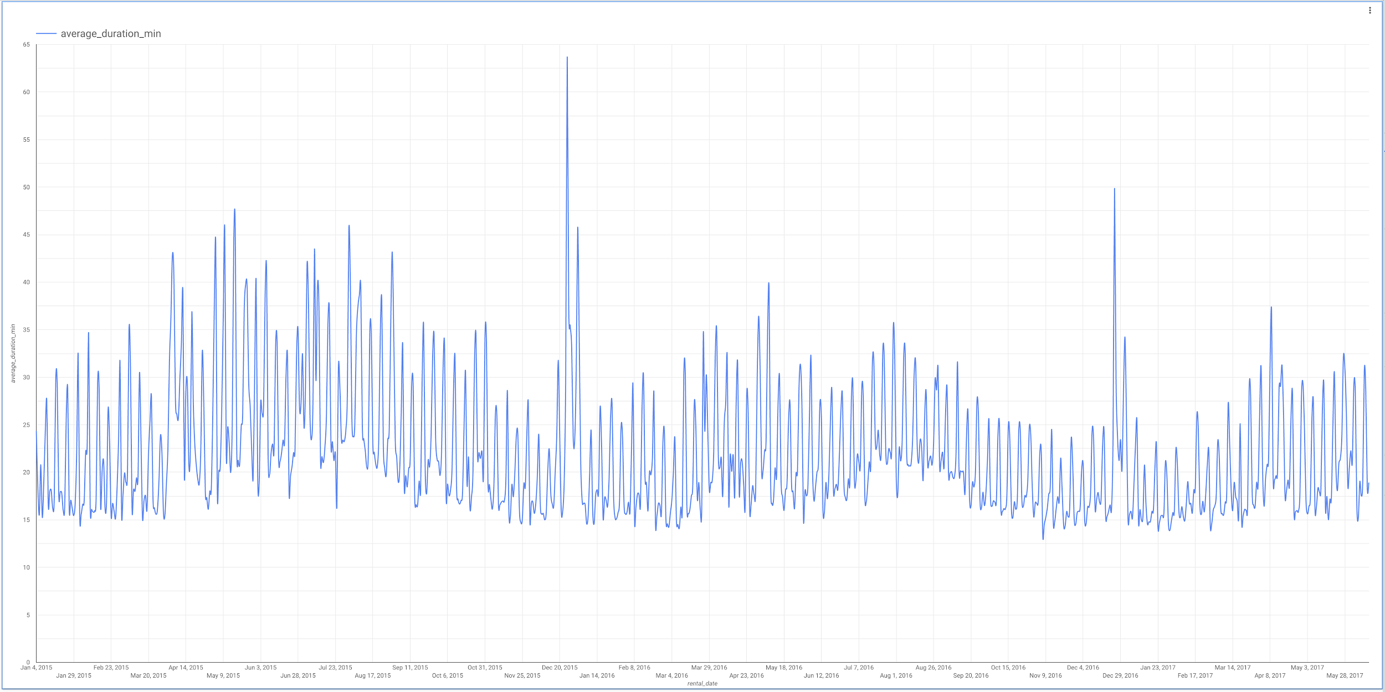
You hire a data analyst to help get you insights on how to keep the right bicycles in stock
Is the aggregation by day sufficient to add business value? …or do we need to cut by station? By day of week?
An analyst might start by looking at the average rental duration by day
Average Bike Rental Duration
2. What’s next day’s duration?
Rented On (Day)

Slide 13
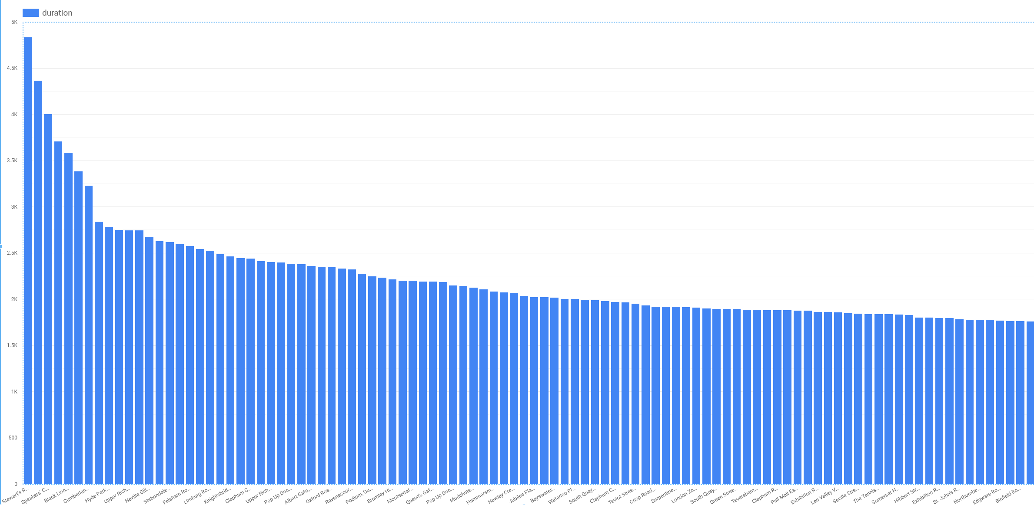
Does the duration of a rental vary by station?
SELECT
start_station_name
, AVG(duration) AS duration
FROM `bigquery-public-data`.london_bicycles.cycle_hire
GROUP BY start_station_name

Slide 14
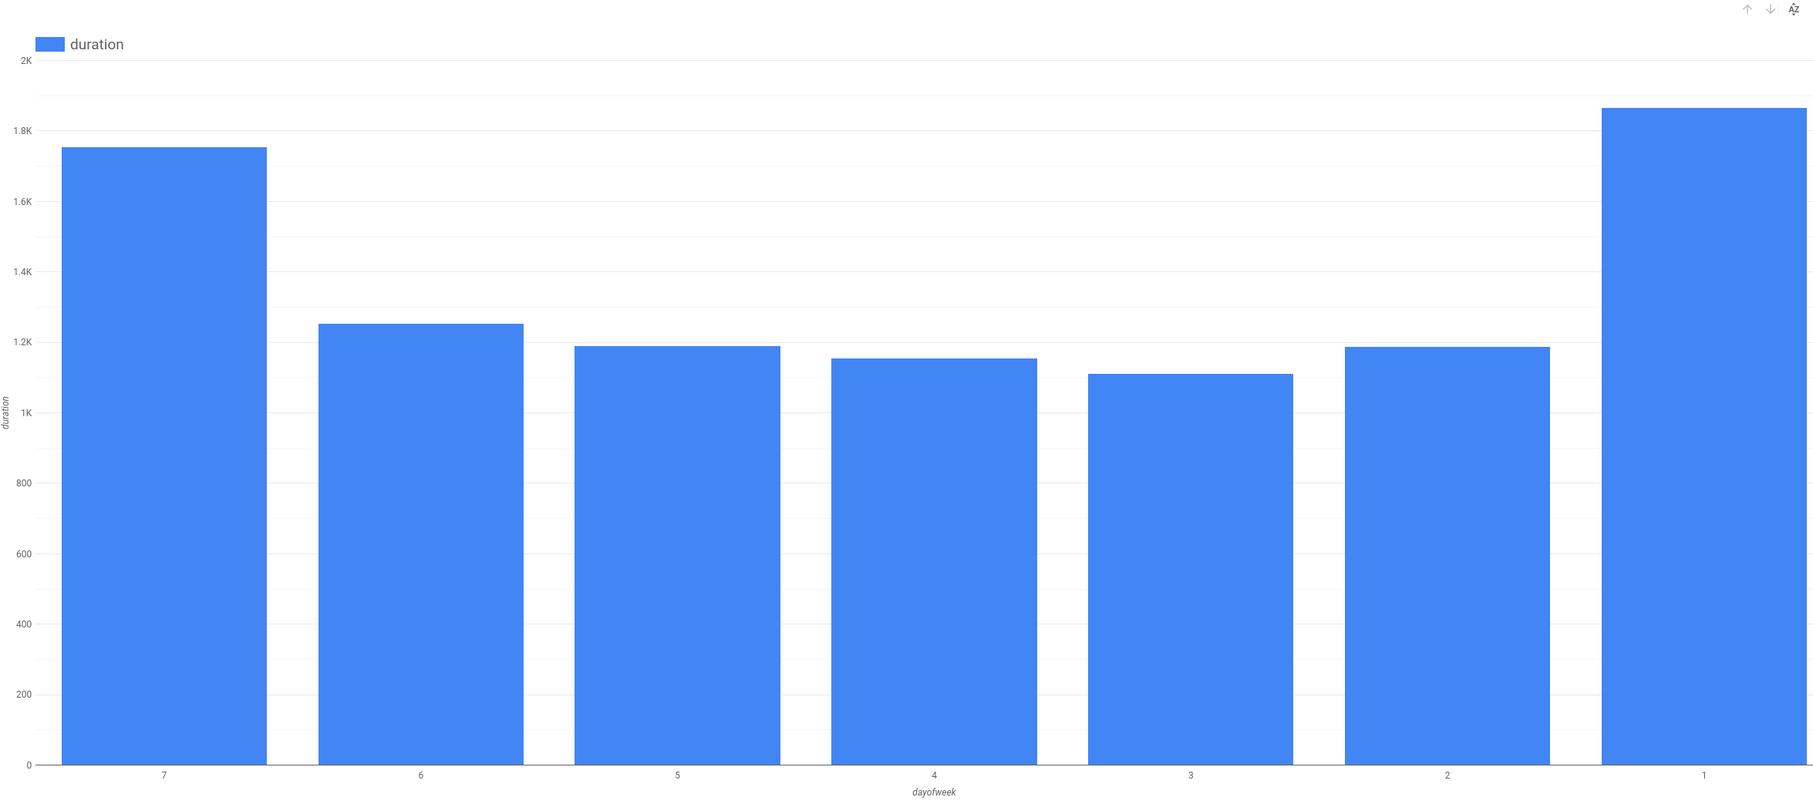
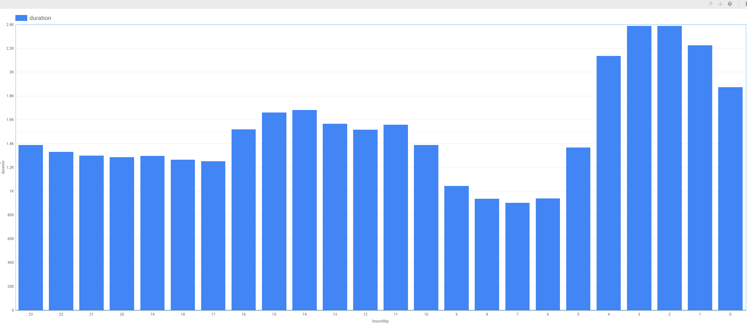
How about the day of the week? Hour of day?
SELECT
EXTRACT(dayofweek
FROM
start_date) AS dayofweek,
AVG(duration) AS duration
FROM
`bigquery-public-data`.london_bicycles.cycle_hire
GROUP BY
dayofweek
SELECT
EXTRACT(hour
FROM
start_date) AS hourofday,
AVG(duration) AS duration
FROM
`bigquery-public-data`.london_bicycles.cycle_hire
GROUP BY
hourofday

Slide 15
This ad-hoc analysis is great but...
A lot of manual, repetitive work involved for the data analyst
Any decisions made will be based on hunches on how all these factors interact
Wouldn’t it be better if we could automate this analysis?

Slide 16
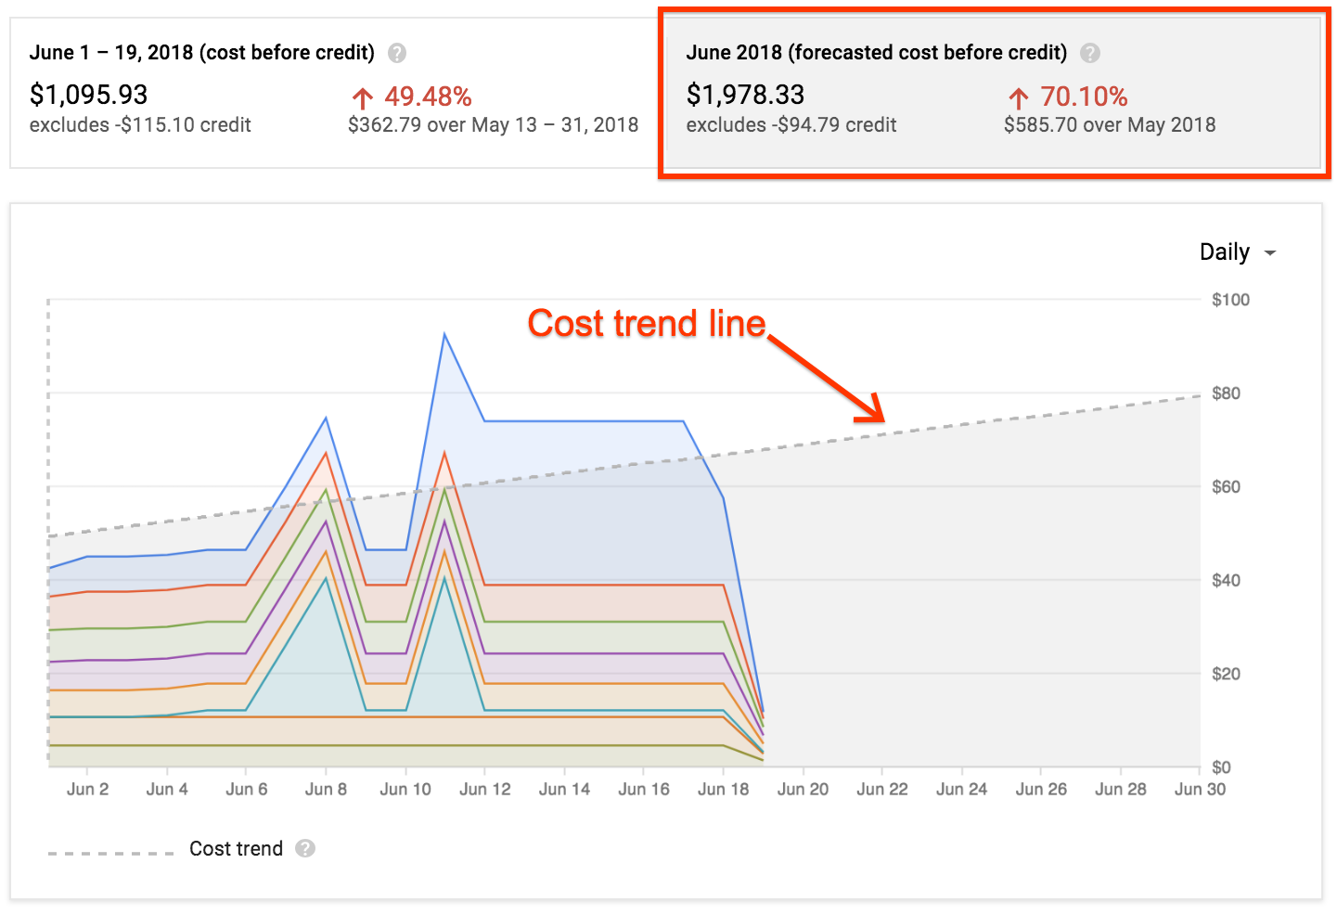
What we need is a ML model to be able to make predictions
Goal: Augment our dashboards with predicted values e.g. prediction for the duration of a rental
As an example, Google augments GCP cost dashboards (descriptive) with forecasted (predictive) usage costs
Notes:
https://cloudplatform.googleblog.com/2018/07/predict-your-future-costs-with-google-cloud-billing-cost-forecast.html

Slide 17
Use the ML model to anticipate what type of bike/how many to stock at your locations
The ML model takes some of the the drudgery out of ad-hoc analysis to help you make truer data-driven decisions
Can build a ML model in BigQuery or AI Platform or AutoML
CREATE OR REPLACE MODEL
bike_model.model_bucketized TRANSFORM(* EXCEPT(start_date),
IF
(EXTRACT(dayofweek
FROM
start_date) BETWEEN 2 AND 6,
'weekday',
'weekend') AS dayofweek,
ML.BUCKETIZE(EXTRACT(HOUR
FROM
start_date),
[5, 10, 17]) AS hourofday )
OPTIONS
(input_label_cols=['duration'],
model_type='linear_reg') AS
SELECT
duration,
start_station_name,
start_date
FROM
`bigquery-public-data`.london_bicycles.cycle_hire

Slide 18
Agenda
AI
From Ad-hoc Data Analysis to Data Driven Decisions
Options for ML models on GCP

Slide 19
















Leverage pretrained models or build your own
Build a Custom Model
Build Custom Model (codeless)
Call a Pretrained Model
AutoML
Cloud TPUs
Compute Engine
Cloud Translation API
Cloud Vision API
Cloud Speech API
Cloud Video
Intelligence API
Data Loss Prevention API
Cloud Speech Synthesis API
Cloud Natural Language API
Cloud Dataproc
Kubernetes Engine
Cloud AI Platform
BigQuery ML
Dialogflow

Slide 20
Module Summary
AI’s impact on industry is huge
Predictive modeling takes data-driven decision making to a new level
The typical data science workflow

